Slide 1
Longformer: The Long-Document Transformer
Paper Authors: Iz Beltagy, Matthew E. Peters, and Arman Cohan

Slide 2
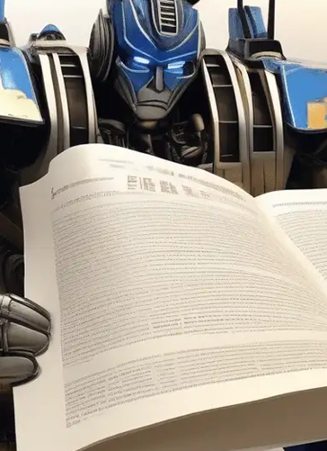
Agenda
1. Introduction
2. Background
3. Longformer Implementation
4. Experiments and Results
5. Conclusion

Slide 3
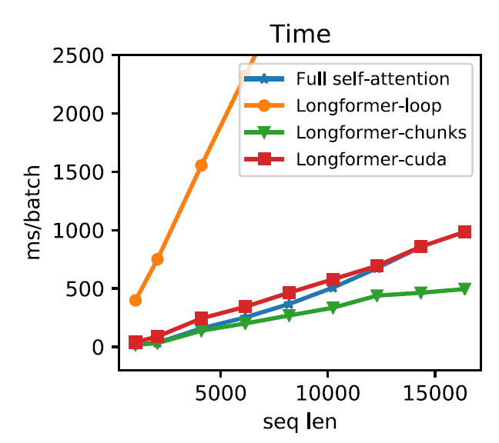
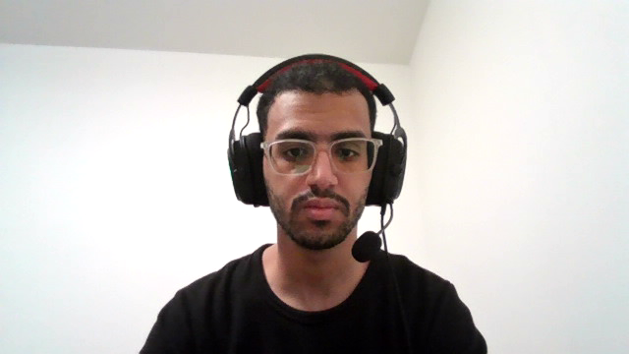
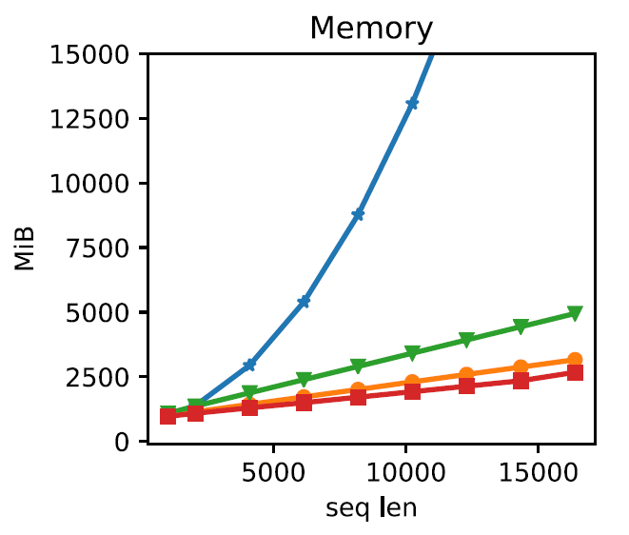
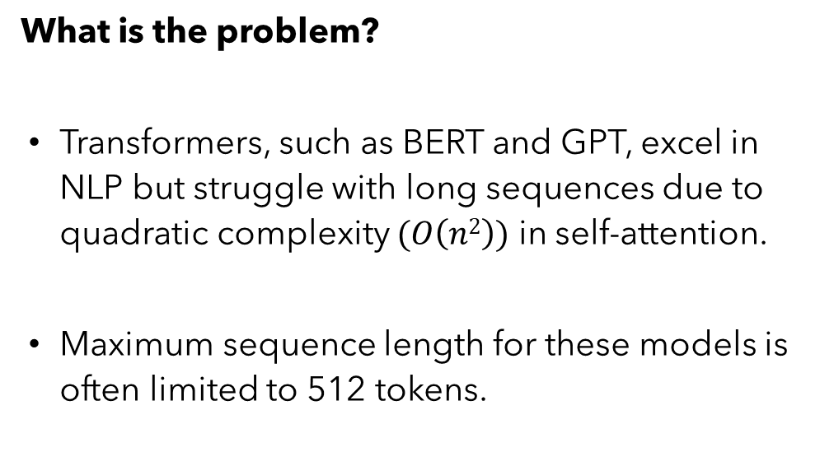
Introduction
What is the problem?
Transformers, such as BERT and GPT, excel in NLP but struggle with long sequences due to quadratic complexity $(O\left(n2\right))$ in self-attention.
Maximum sequence length for these models is often limited to 512 tokens.
Fig 1: Runtime and memory of full self attention and different implementations of Longformer’s self-attention

Slide 4

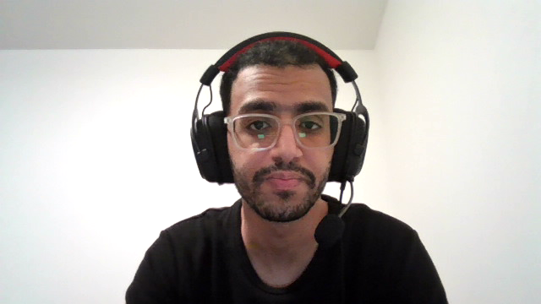
Background (Existing Solutions for Long Sequences)
Truncation or Chunking Methods
To handle long sequences, models often use truncation or split the input into chunks.
Limitations:
Information Loss.
Complicated Modeling.
Fig 2: Transformer Architecture

Slide 5
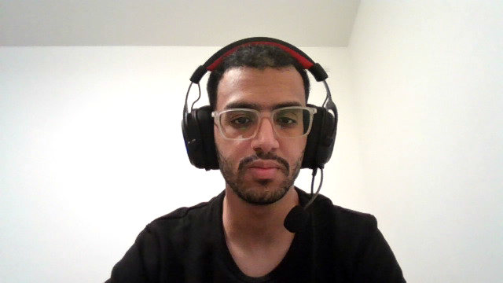
Background (Existing Solutions for Long Sequences)
Sparse Attention Models
Sparse Transformers (e.g., Reformer, Sparse Transformer) attempt to reduce the quadratic complexity by using sparse attention patterns instead of full pairwise attention.
Limitations:
Lack of Flexibility.
Contextual Understanding.
Fig 2: Transformer Architecture

Slide 6
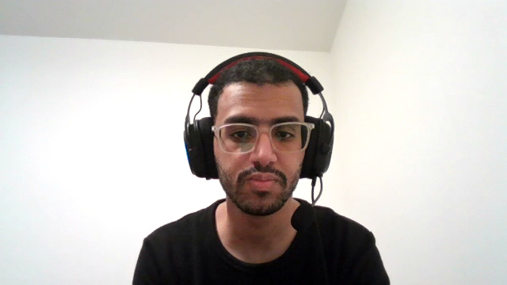
Background (Existing Solutions for Long Sequences)
Two-Stage Model for QA Tasks
In domain-specific QA tasks, a common approach involves a two-stage process:
Stage 1: Document Retrieval.
Stage 2: Answer Extraction.
Limitations:
Context Dependency.
Low Efficiency.
Fig 2: Transformer Architecture

Slide 7
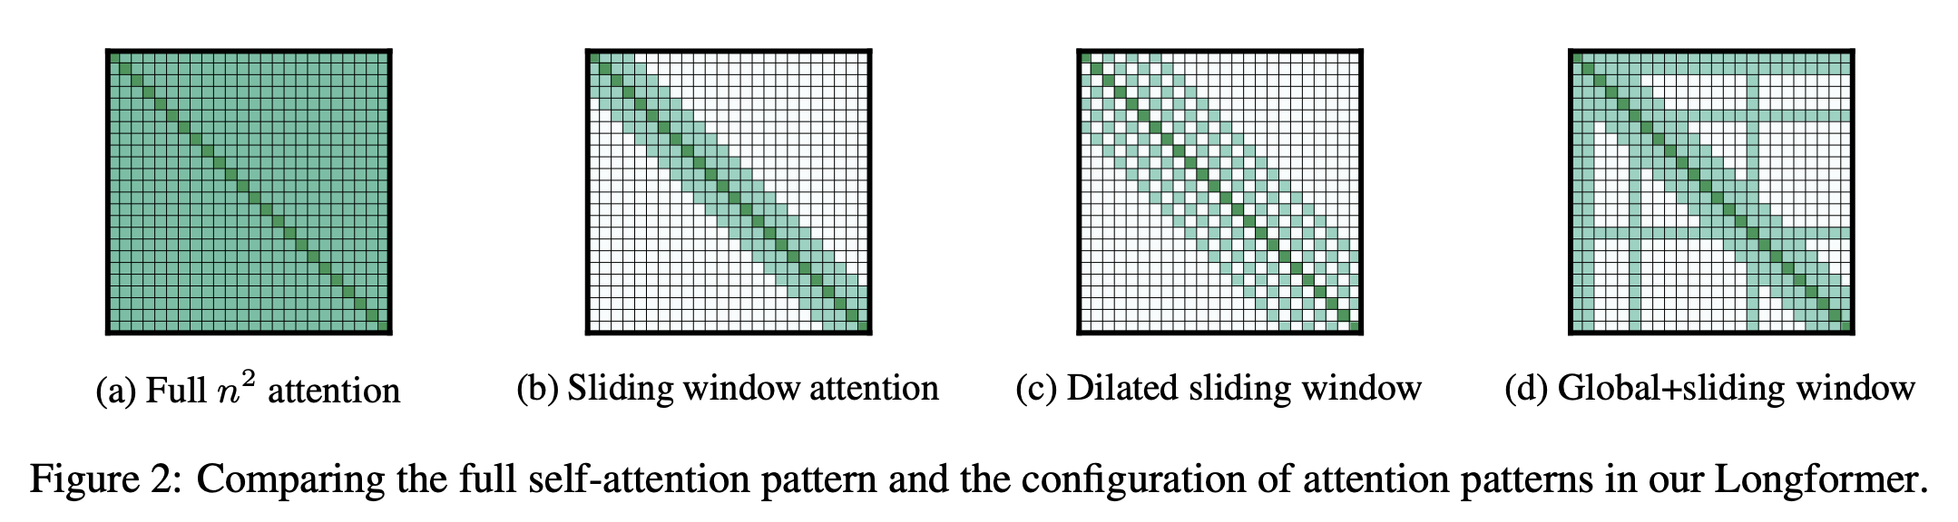
Longformer Implementation
Unlike the full self-attention, the proposed attention pattern scales linearly with the input sequence, making it efficient for longer sequences. This section discusses the design and implementation of this attention pattern.
Fig 3: Comparing the full self-attention pattern and the configuration of attention patterns in Longformer.

Slide 8
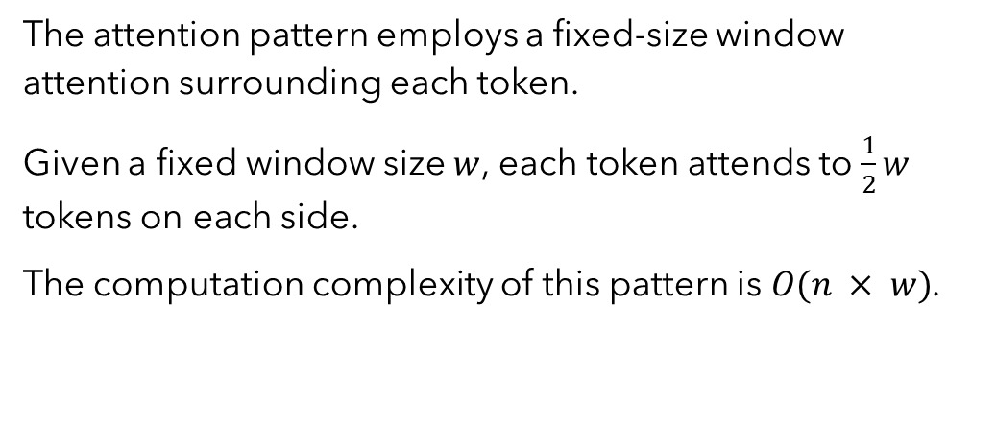
Sliding window attention
The attention pattern employs a fixed-size window attention surrounding each token.
Given a fixed window size $w$, each token attends to $\frac{1}{2}w$ tokens on each side.
The computation complexity of this pattern is $O(n × w)$.

Slide 9
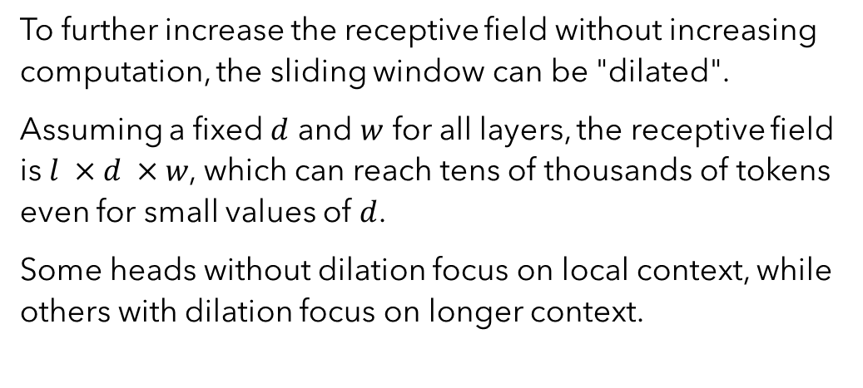
Dilated sliding window
To further increase the receptive field without increasing computation, the sliding window can be "dilated".
Assuming a fixed $d$ and $w$ for all layers, the receptive field is $l ×d ×w$, which can reach tens of thousands of tokens even for small values of $d$.
Some heads without dilation focus on local context, while others with dilation focus on longer context.

Slide 10
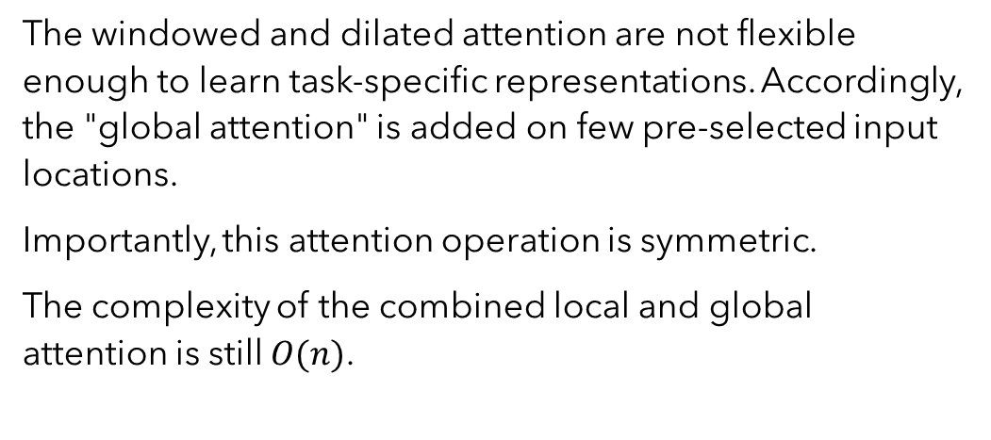
Global+sliding window
The windowed and dilated attention are not flexible enough to learn task-specific representations. Accordingly, the "global attention" is added on few pre-selected input locations.
Importantly, this attention operation is symmetric.
The complexity of the combined local and global attention is still $O(n)$.

Slide 11
Experiments and Results
Key Tasks Evaluated with Longformer:
Autoregressive Language Modeling
Question answering
Coreference Resolution
Document Classification

Slide 12
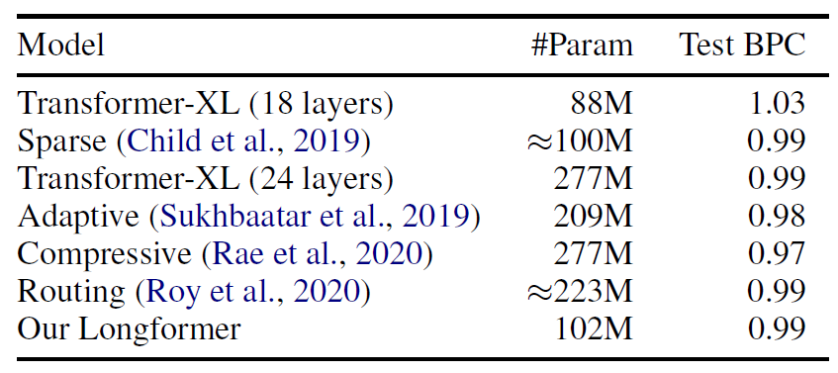
Table 1: Performance of large models on enwik8
Autoregressive Language Modeling

Slide 13
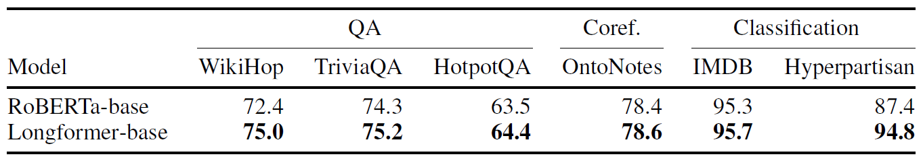
Table 2: Summary of finetuning results on QA, coreference resolution, and document classification.
QA, coreference resolution, and document classification

Slide 14
Conclusion
Strengths
Limitations
Efficient scaling for long documents.
Consistent state-of-the-art performance.
Flexible for diverse NLP tasks.
Requires task-specific global attention design.
Less effective for very short inputs.

Slide 15
Thank You!
Presented by: Abdullah Abdelrazek, Mariia Halchynska, Nadiia Duiunova

